Slide 1
ATM SERVICE USING EMULATOR 8086
REVIEW -3

Slide 2
Team Members
N. SURYA PRAKASH 19BPS1052
M.HANUMAN SAI 19BPS1066
GOPU.VIJAY 19BPS1078

Slide 3
PROJECT PHASE DIVISION PHASE 1 : PASSWORD CHECK PHASE 2 : DISPLAY BANKING OPTIONS PHASE 3 : BALANCE ENQUIRY PHASE 4 : MONEY WITHDRAW PHASE 5 : TRANSFER MONEY PHASE 6 : CANCEL TRANSACTION

Slide 4
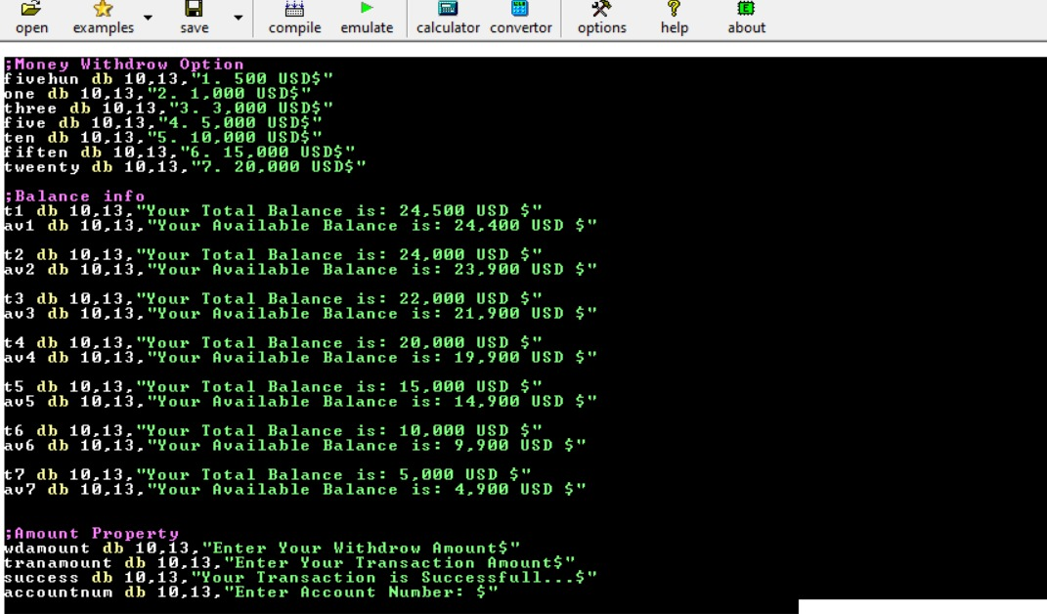
PHASE 4 : MONEY WITHDRAW (CHOICE OF 7 TYPES OF AMOUNT TO WITHDRAW)
CODE:

Slide 5
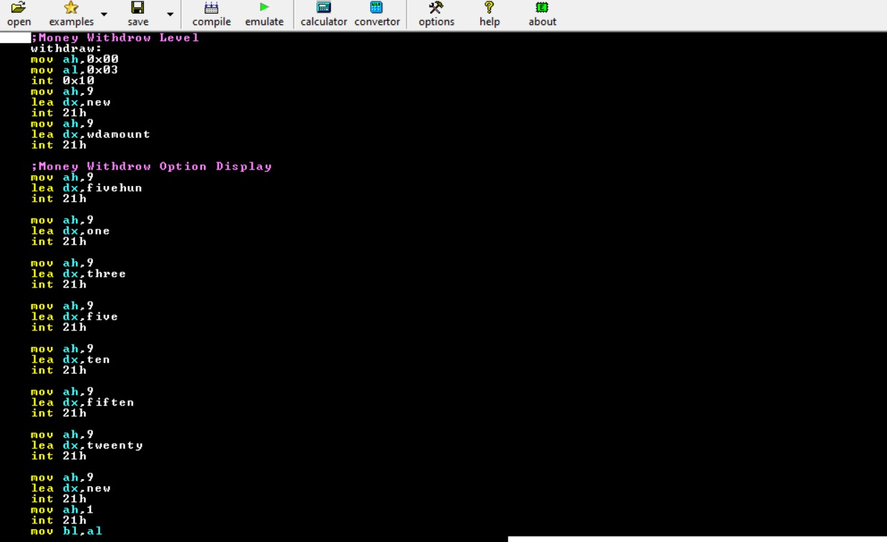
……

Slide 6
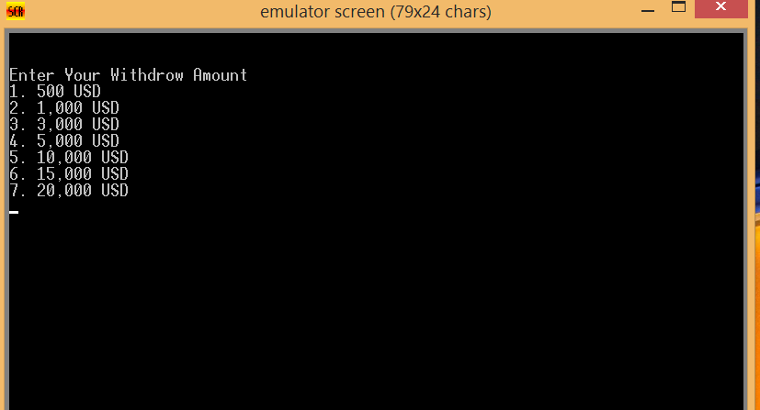
AFTER EXECUTION

Slide 7
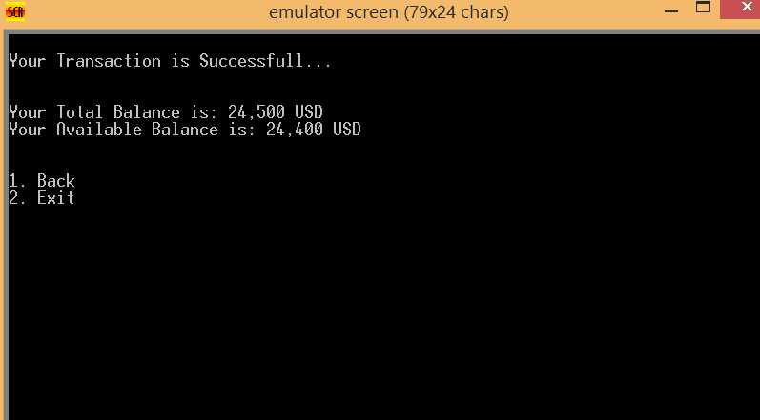
……..

Slide 8
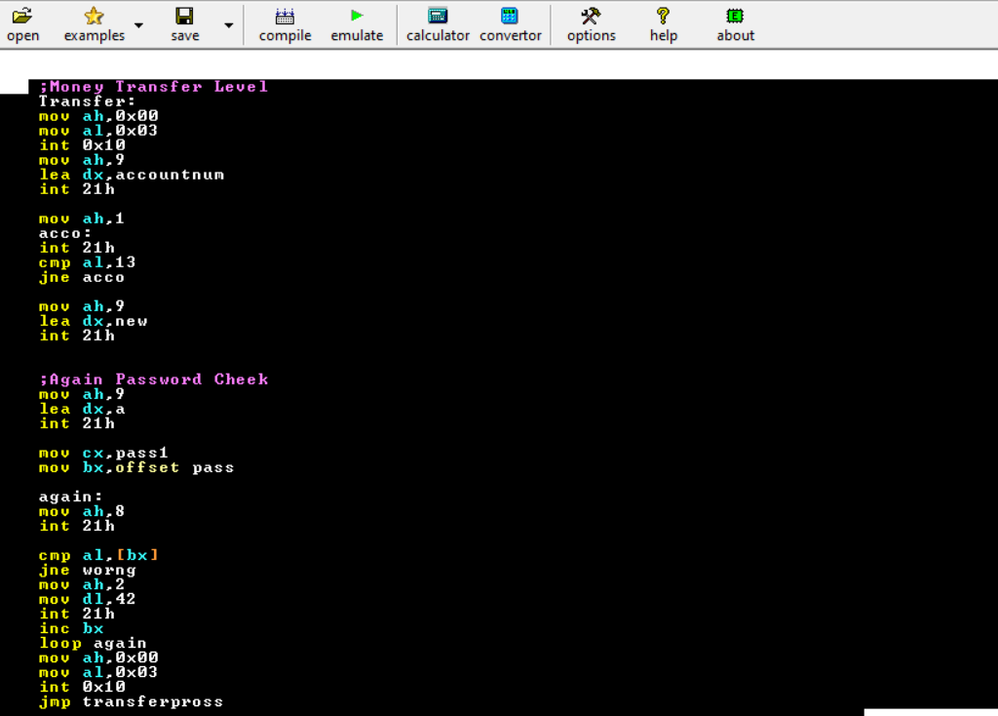
PHASE 5 TRANSFER MONEY

Slide 9
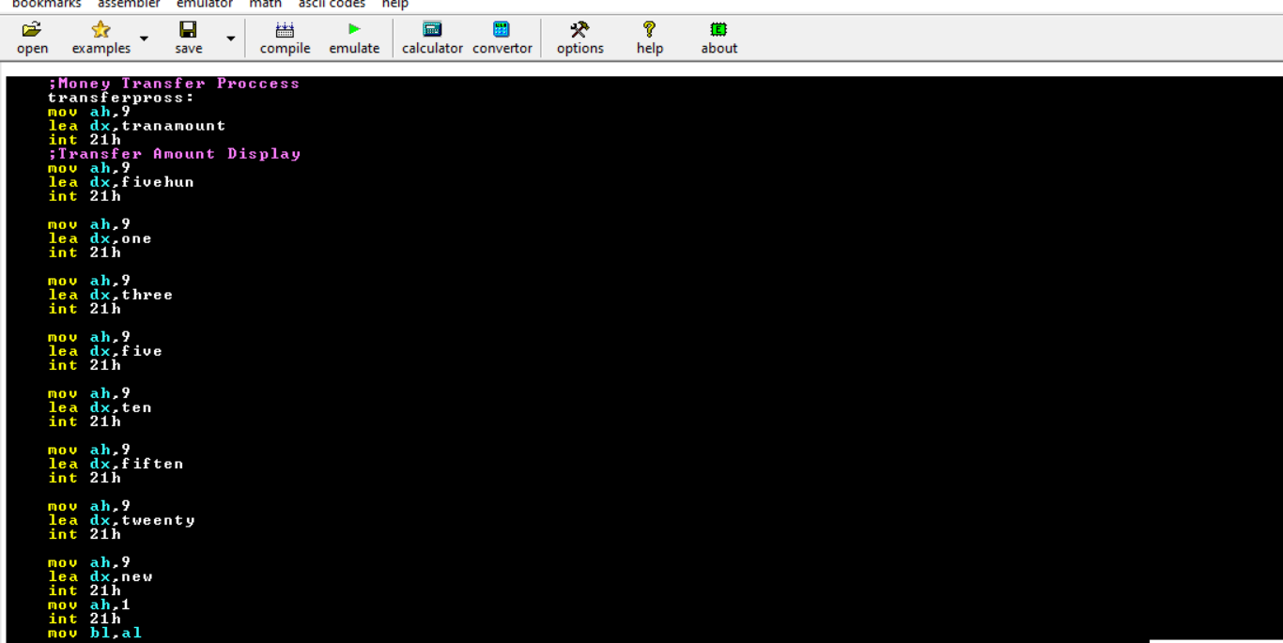

Slide 10
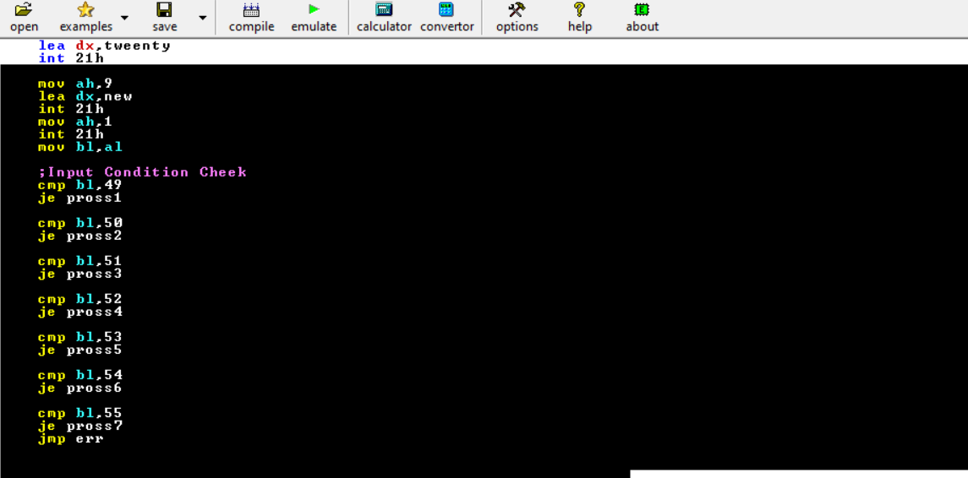

Slide 11
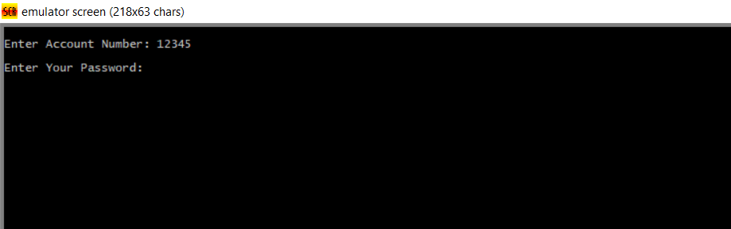
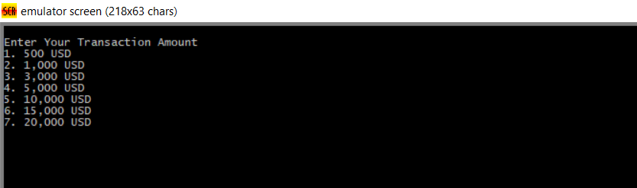
AFTER EXECUTION

Slide 12
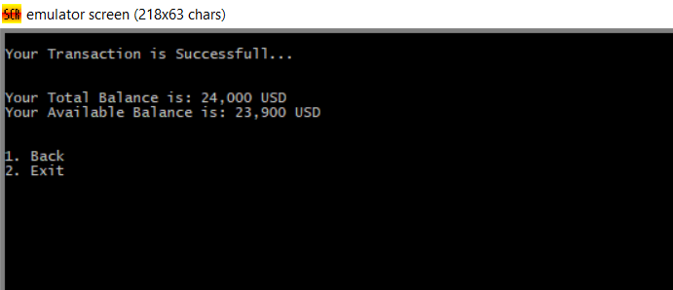
AFTER SELECTING OPTION 2 (TRANSFER OF 1K USD)

Slide 13
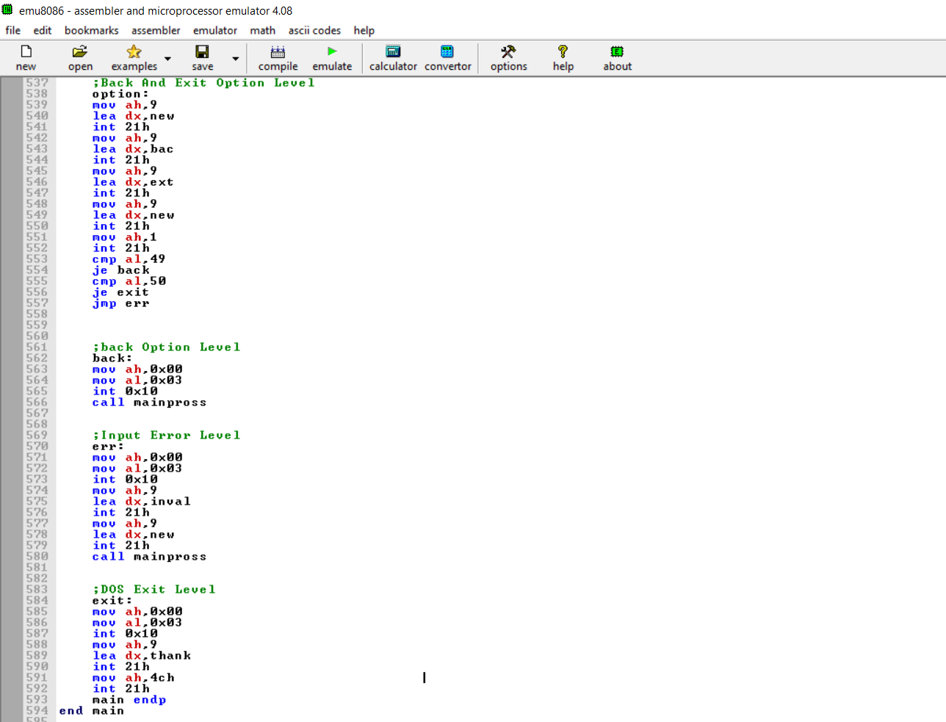
PHASE 6 : CANCEL TRANSACTION
CODE :

Slide 14
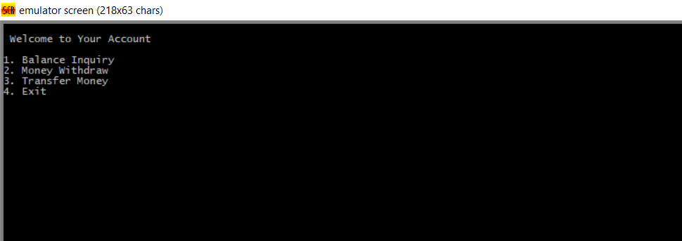
AFTER EXECUTION

Slide 15
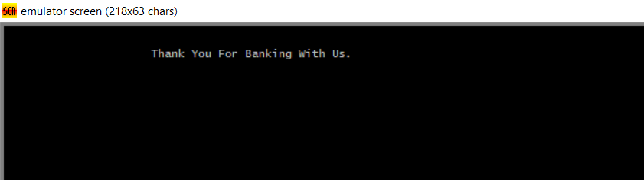
Selecting option 4 for cancel the transaction
Displays a pop-up message “Thank You For Banking with us”.

